Slide 1
Object Oriented Programming through C++
Course Code: 241CS008
Course Instructor:
Dr. Chandra Sekhar K
Associate Professor,
CSE Dept.

Slide 2
L T P C
2 0 2 4
Course Outcomes:
At the end of the course, student will be able to:
CO1: Make use of C and C++ programming constructs to demonstrate OOP concepts.
CO2: Develop applications using constructor and destructor.
CO3: Apply C++ features for problem solving.
CO4: Apply inheritance concepts and file I/O to solve a given problem.
CO5: Design C++ classes using templates and STL.

Slide 3
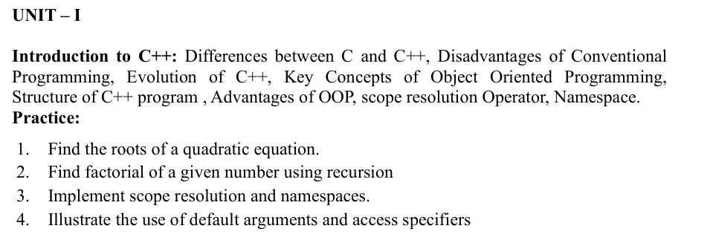
SYLLABUS

Slide 4
Introduction to C++
C++ is a powerful C++ is a general-purpose programming language.
Developed by Bjarne Stroustrup at Bell Labs.
It is designed to be used for writing software in a wide variety of application domains, not just for a specific type of task.

Slide 5
Versatility: C++ can be used to develop system software (like operating systems), application software (like games or GUIs), drivers, embedded firmware, and more.
No single domain: It's not limited to one field like web development, numerical computation, or graphics — it can do all of those.
Performance and control: It gives low-level memory access (like C), but also supports high-level abstractions (like object-oriented programming),
Suitable for both system-level and application-level development.

Slide 6
Example Use Cases:
Operating systems (e.g., parts of Windows, Linux components)
Game engines (e.g., Unreal Engine)
Desktop applications (e.g., Adobe software)
Embedded systems
Financial modeling and simulations

Slide 7
Evolution of C++
It is as an extension to the C language.
C Language (1972 - Dennis Ritchie) Created at Bell Labs.
Designed for system programming and operating systems (e.g., UNIX).
Need for Better Software Engineering Practices
Software systems became large and complex.
Limitations of procedural programming exposed.

Slide 8
Originallyy called as C with Classes (1979 - Bjarne Stroustrup)
Bjarne Stroustrup at Bell Labs extended C by adding classes.
Introduced OOP principles while retaining C’s efficiency.
Developed in the year 1983
C++ (1985 - Official Release)
Enhanced with features like classes, objects, inheritance, polymorphism, operator overloading, etc.
Backward compatible with C (you can run most C code in C++).

Slide 9
Year | Evolution
1972 | C Language
1979 | C with Classes
1983-85 | First version of C++
1998 | ISO Standard C++98
2011+ | Modern C++ (C++11, C++14, C++17, C++20, C++23)
C++ evolved to overcome the limitations of C by supporting Object-Oriented Programming.

Slide 10
Differences between C and C++
Feature | C | C++
Paradigm | Procedural | Procedural + Object-Oriented
Encapsulation | Not supported | Supported via classes and objects
Data Security | Data is not secured (Global scope) | Supports data hiding through Access Specifiers
Inheritance & Polymorphism | Not supported | Supported
Standard Input/Output | scanf() / printf() | cin / cout
Exception Handling | Manual (via return codes) | Built-in using try-catch blocks
File Extension | .c | .cpp

Slide 11
C is mainly used for system-level programming.
C++ is used for application-level programming and supports OOP.
The main difference is C++ supports classes and objects, while C does not.

Slide 12
Disadvantages of Conventional Programming (Procedural Programming)
Conventional programming like C has the following limitations:
Lack of Data Security
All variables are global or passed around manually.
No mechanism to hide data (no encapsulation).
Code Reusability
Difficult to reuse code, especially if functions rely on global variables.
Scalability Issues
As codebase grows, managing and modifying the program becomes complex.
Hard to track changes or debug in large applications.

Slide 13
Poor Mapping to Real World
Procedural approach is not intuitive for modeling real-world entities.
Real-world objects and behaviors are hard to simulate.
No Polymorphism or Inheritance
Can't define multiple behaviors for the same function name (no overloading).
Can't reuse or extend functionality using inheritance.
As software complexity increased, the need for better structure, reuse, and maintainability led to the evolution of OBJECT-ORIENTED PROGRAMMING (OOP).

Slide 14
Install C++
If you want to run C++ on your own computer, you need two things:
A text editor, like Notepad, to write C++ code
A compiler, like GCC, to translate the C++ code into a language that the computer will understand
C++ IDE (Integrated Development Environment)

Slide 15
Example 1: with namespace
#include <iostream>
using namespace std;
int main() {
cout << "Hello, CPP " ;
return 0;
}
Example 2: without namespace
#include <iostream>
int main()
{
std::cout << "Hello, CPP" ;
return 0;
}

Slide 16
Key Concepts of Object-Oriented Programming
Class
Object
Encapsulation
Abstraction
Inheritance
Polymorphism
Message Passing

Slide 17
Class
A blueprint or template for creating objects.
Defines attributes (data) and methods (functions) common to all objects of that type.
Example:
class Car
{
public:
string brand;
void drive()
{
cout << "Driving the car";
}
};

Slide 18
Object
A real-world entity created based on a class.
It holds actual data and can access class methods.
Example: Car c1, c2;
Encapsulation
Wrapping of data and functions into a single unit (class).
Ensures data hiding and security by using access specifiers (private, public, protected).
Example: class Student {
private:
int rollNo;
public:
void setRollNo(int r) { rollNo = r; }
int getRollNo() { return rollNo; }
};

Slide 19
Abstraction
Hides complex internal details and shows only necessary features to the user.
Achieved using abstract classes or interfaces (pure virtual functions in C++).
Example:
class Shape
{
public:
virtual void draw() = 0; // pure virtual function
};

Slide 20
Inheritance
Mechanism where a class acquires properties and behaviors of another class.
Promotes code reusability.
Types: Single, Multilevel, Hierarchical, Multiple (in C++), Hybrid.
Example:
class Vehicle
{ public:
void start()
{ cout << "Starting vehicle"; }
};
class Car : public Vehicle
{ public:
void drive()
{ cout << "Driving car"; }
};

Slide 21
Polymorphism
Ability of functions or objects to behave differently based on context.
Types:
Compile-time (Static): Function overloading, Operator overloading.
Run-time (Dynamic): Function overriding using virtual functions.
Example:
class Animal {
public:
virtual void sound()
{ cout << "Some sound"; }
};
class Dog : public Animal {
public:
void sound() override { cout << "Bark"; }
};

Slide 22
Message Passing
Objects communicate by sending and receiving data (messages).
A method call is an example of message passing.

